Slide 1


Slide 2

Data Science is all about experimentation
•
Three stages for each experiment:
Thinking
Coding
Execution
More experiments = higher chance of
success
•

Slide 3

Poor man's solution
•
Code project in a (long) single ﬁle
Problem: Not maintainable
No clear boundaries among tasks
Leads to unwanted interactions We need reproducible and
maintainable projects
•
•

Slide 4

Why bother about maintainability?
Without a lot of structure, we forget what we’ve done in the past, we can’t read each others’ work, and we can’t test whether what we’ve done is correct.¹
— Patrick Ball
Image: https://unsplash.com/photos/r6mBXuHnxBk
¹ https://hrdag.org/2016/06/14/the-task-is-a-quantum-of-workflow/

Slide 5
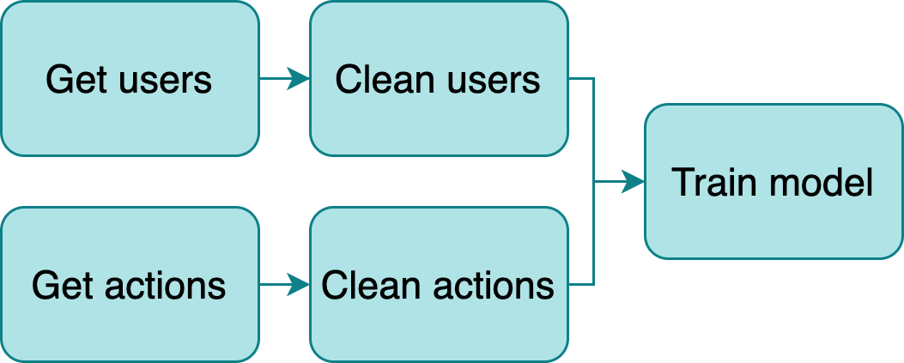
Build a data pipeline
•
Break down logic in small tasks
Outputs become inputs of downstream
tasks
New challenge: Manage structure
Multiple ﬁles
Route outputs
Orchestrate execution
•
•

Slide 6

Current approach: Workﬂow managers
•
Frameworks to develop pipelines (Make, Airﬂow, Luigi, etc)
Problems:
Learn a new tool
Write pipeline code
Adds unnecessary complexity
•
Image: https://unsplash.com/photos/l090uFWoPaI

Slide 7
Ploomber
Adheres to a convention over conﬁguration philosophy, to allows us to write pipelines with a focus on usability.
Three conventions:
Each task is a script
Scripts declare dependencies via an upstream variable
And outputs via a product variable

Slide 8
Main features
•
Python, R and SQL⁴ supported⁵
Parametrized pipelines with auto-generated CLI Testing (i.e., run data tests upon task execution) Debugger integration (pdb and ipdb)
•
•
•
Any database with a DBAPI 2.0 client or compatible with SQLAlchemy is supported
Languages that have Jupyter kernels are supported with a few limita9ons

Slide 9

R example 1
clean.R:
# + tags=["parameters"]
upstream = list('raw')
product = NULL
# -
df = read.csv(upstream$raw$data)
write.csv(df, product$data)

Slide 10
Python example
train-model.py:
import pandas as pd
# + tags=["parameters"]
upstream = ['clean-users', 'clean-actions'] product = {'nb': 'output/model-evaluation.ipynb',
'model': 'output/model.pickle'}
# +
users = pd.read_parquet( upstream['clean-users']['data'])
actions = pd.read_parquet( upstream['clean-actions']['data'])
# code continues...

Slide 11
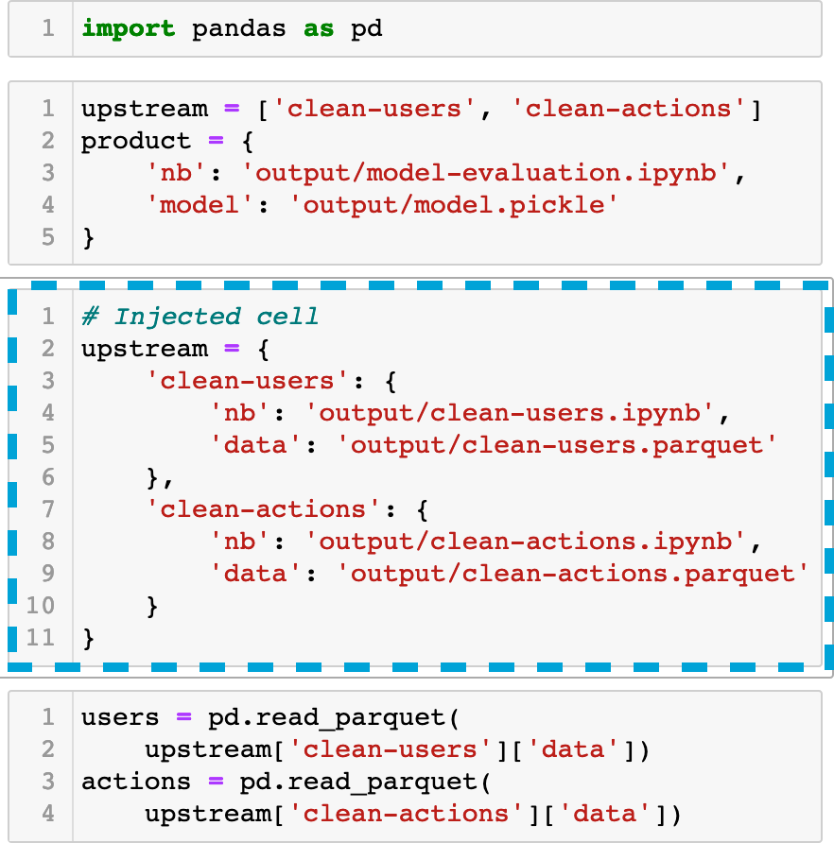
Cell injection
import pandas as pd
# + tags=["parameters"]
upstream = ['clean-users', 'clean-actions'] product = {'nb': 'output/model-evaluation.ipynb',
'model': 'output/model.pickle'}
# +
users = pd.read_parquet( upstream['clean-users']['data'])
actions = pd.read_parquet( upstream['clean-actions']['data'])
# code continues...

Slide 12
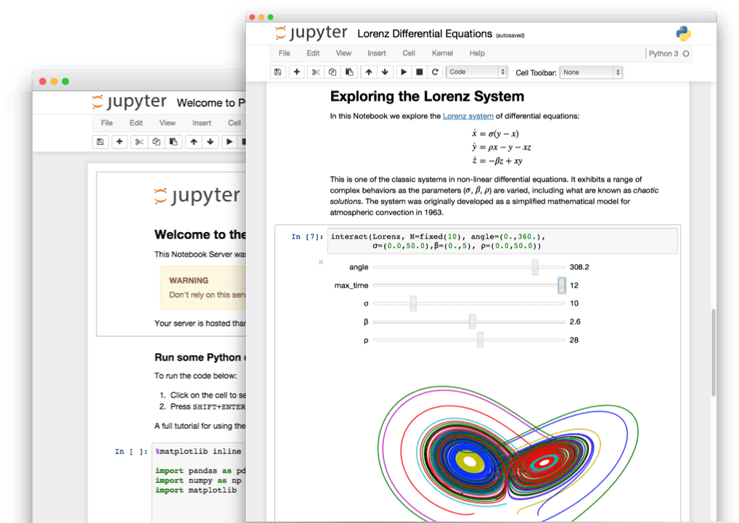
Tasks as notebooks
•
Tasks are converted to notebooks (.ipynb) before execu5on²
No need to write code to save tables or charts
Generate logs for each execution
•
•
² Thanks to papermill! h2ps://github.com/nteract/papermill

Slide 13
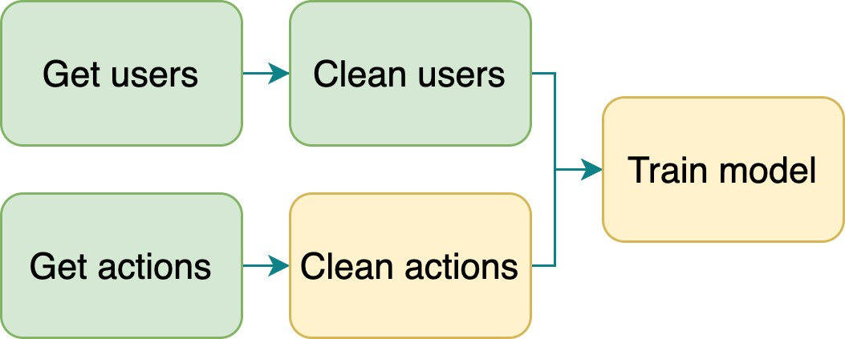
Build process
Extract upstream and product
Determine execution order using extracted upstream dependencies
Inject code. Replace the list of dependency names with a map of names to products
Execute the pipeline (skips up-to-date tasks)

Slide 14
Sample workﬂow
1. Input
3. Result
get-users.py clean-users.py get-actions.py clean-actions.py train-model.py
output/
get-users.ipynb users.parquet
clean-users.ipynb clean-users.parquet
get-actions.ipynb actions.parquet
clean-actions.ipynb clean-actions.parquet
model-evaluation.ipynb model.pickle
2. Execute
ploomber build --entry-point .

Slide 15

Integration with Jupyter
•
Scripts open as notebooks³
(Temporary) cell injection
Ensures no hidden state by running
ploomber build
•
•
³ Thanks to jupytext! https://github.com/mwouts/jupytext

Slide 16
Demo

Slide 17
Main features
•
Python, R and SQL⁴ supported⁵
Parametrized pipelines with auto-generated CLI Testing (i.e., run data tests upon task execution) Debugger integration (pdb and ipdb)
•
•
•
Any database with a DBAPI 2.0 client or compatible with SQLAlchemy is supported
Languages that have Jupyter kernels are supported with a few limita9ons

Slide 18
Resources
Install: pip install ploomber
For updates/questons/feedback, follow me on LinkedLn:
https://docs.ploomber.io/en/latest/
https://docs.ploomber.io/en/latest/user-guide/r-support.html
Examples: github.com/ploomber/projects Website: ploomber.io
This presentation: blancas.io/talks/jupytercon-20.pdf
•
•
•
•

Slide 19
Thanks for watching!

